Slide 1
Intro CTS CTO
Clock Tree Synthesis
How to Synchronize your own chip
Ahmed Abdelazeem
Faculty of Engineering Zagazig University
RTL2GDSII Flow, March 2022
ASIC Physical Design

Slide 2
Intro CTS CTO
Table of Contents
Introduction
Clock Tree Synthesis
Clock Tree Optimization
ASIC Physical Design

Slide 3
Intro CTS CTO
CTS CTS Balance Skew
Table of Contents
Introduction
Clock Tree Synthesis
Clock Tree Optimization
ASIC Physical Design

Slide 4
Design Status, Start of CTS Phase
Intro CTS CTO CTS CTS Balance Skew
Placement - completed
Power and ground nets – prerouted Estimated congestion - acceptable Estimated timing - acceptable ( 0ns slack)
Estimated max cap/transition – no violations High fanout nets:
Reset, Scan Enable synthesized with buffers
Clocks are still not buffered
ASIC Physical Design

Slide 5
Design Status, Start of CTS Phase
Intro CTS CTO CTS CTS Balance Skew
Placement - completed
Power and ground nets – prerouted Estimated congestion - acceptable Estimated timing - acceptable ( 0ns slack)
Estimated max cap/transition – no violations High fanout nets:
Reset, Scan Enable synthesized with buffers
Clocks are still not buffered
Question
Why are there no buffers on clock nets?
ASIC Physical Design

Slide 6
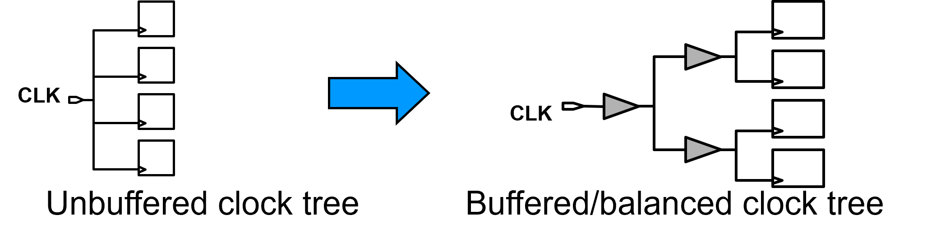
Intro CTS CTO
CTS CTS Balance Skew
CTS Problem
CTS is the process of distributing clock signals to clock pins based on physical/layout information
After placement of cells the tree of synchronization is synthesized
Balanced clock tree is synchronized with the addition of buffers
After routing CT optimization is made
ASIC Physical Design

Slide 7
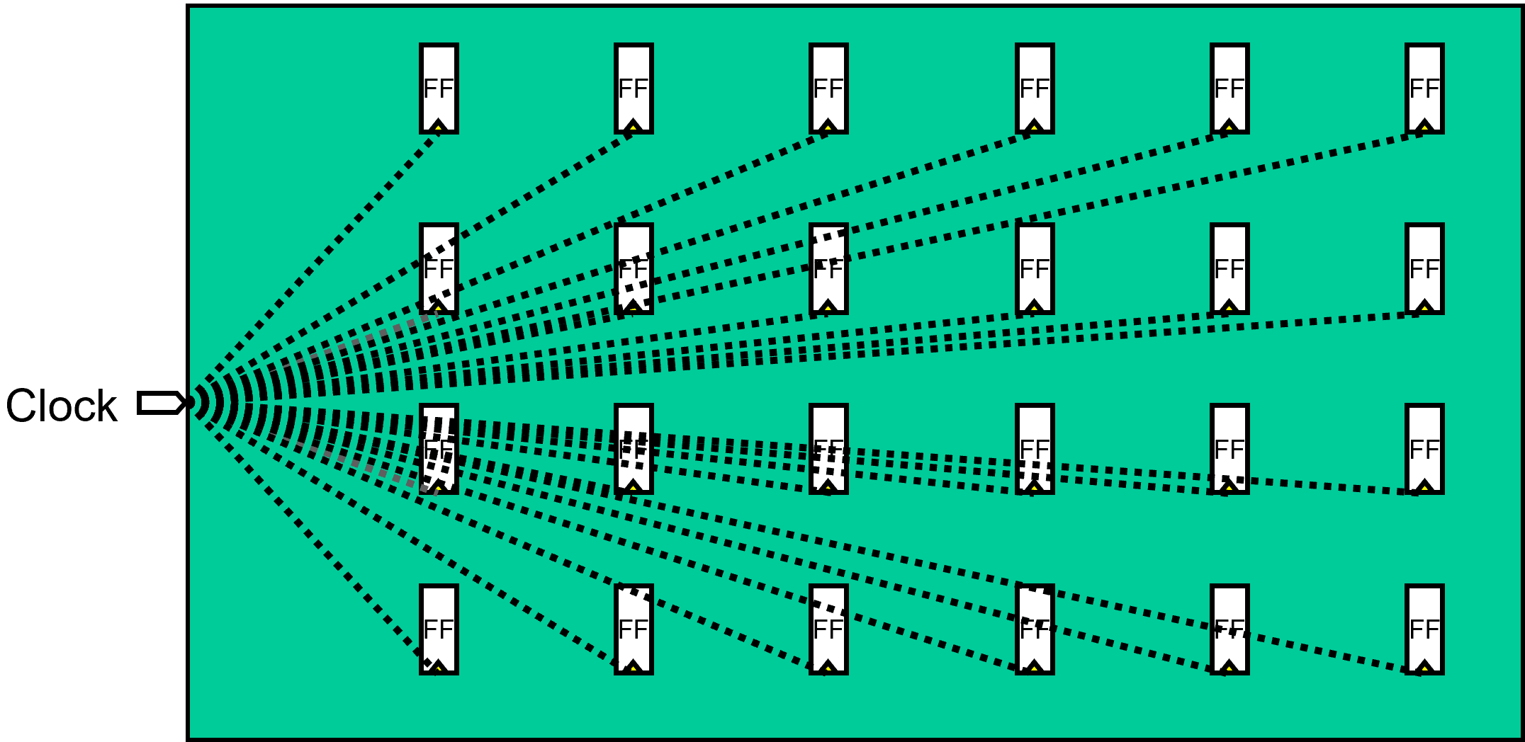
Intro CTS CTO
CTS CTS Balance Skew
Starting Point before CTS
All clock pins are driven by a single clock source
All clock pins are from a source of clock pulses in various geometrical distances
ASIC Physical Design

Slide 8
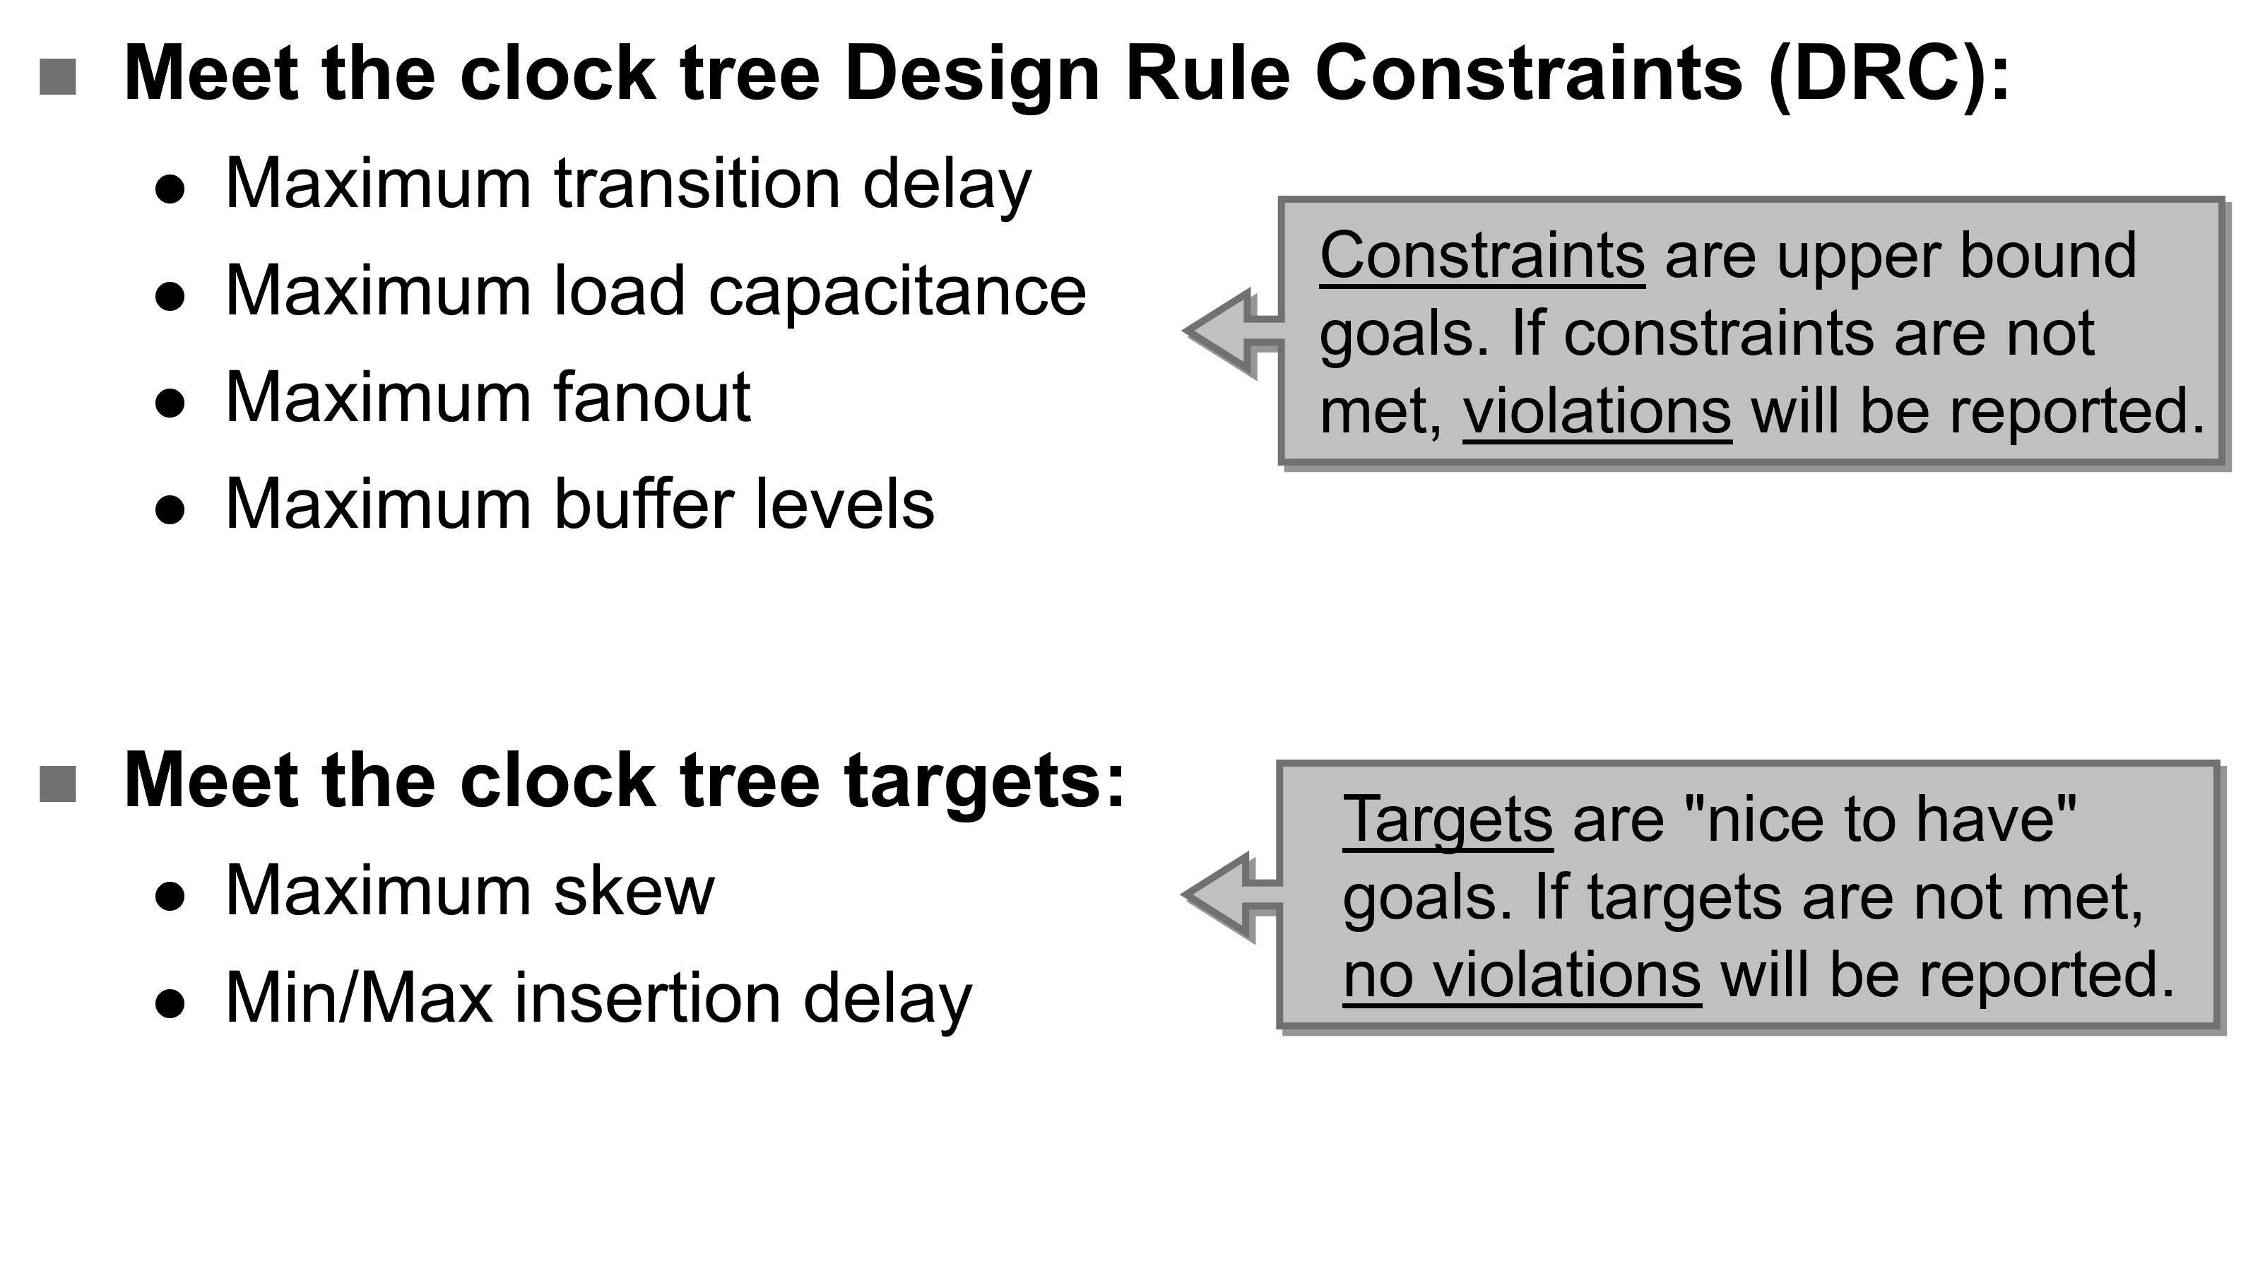
Intro CTS CTO
CTS CTS Balance Skew
CTS Goals
ASIC Physical Design

Slide 9
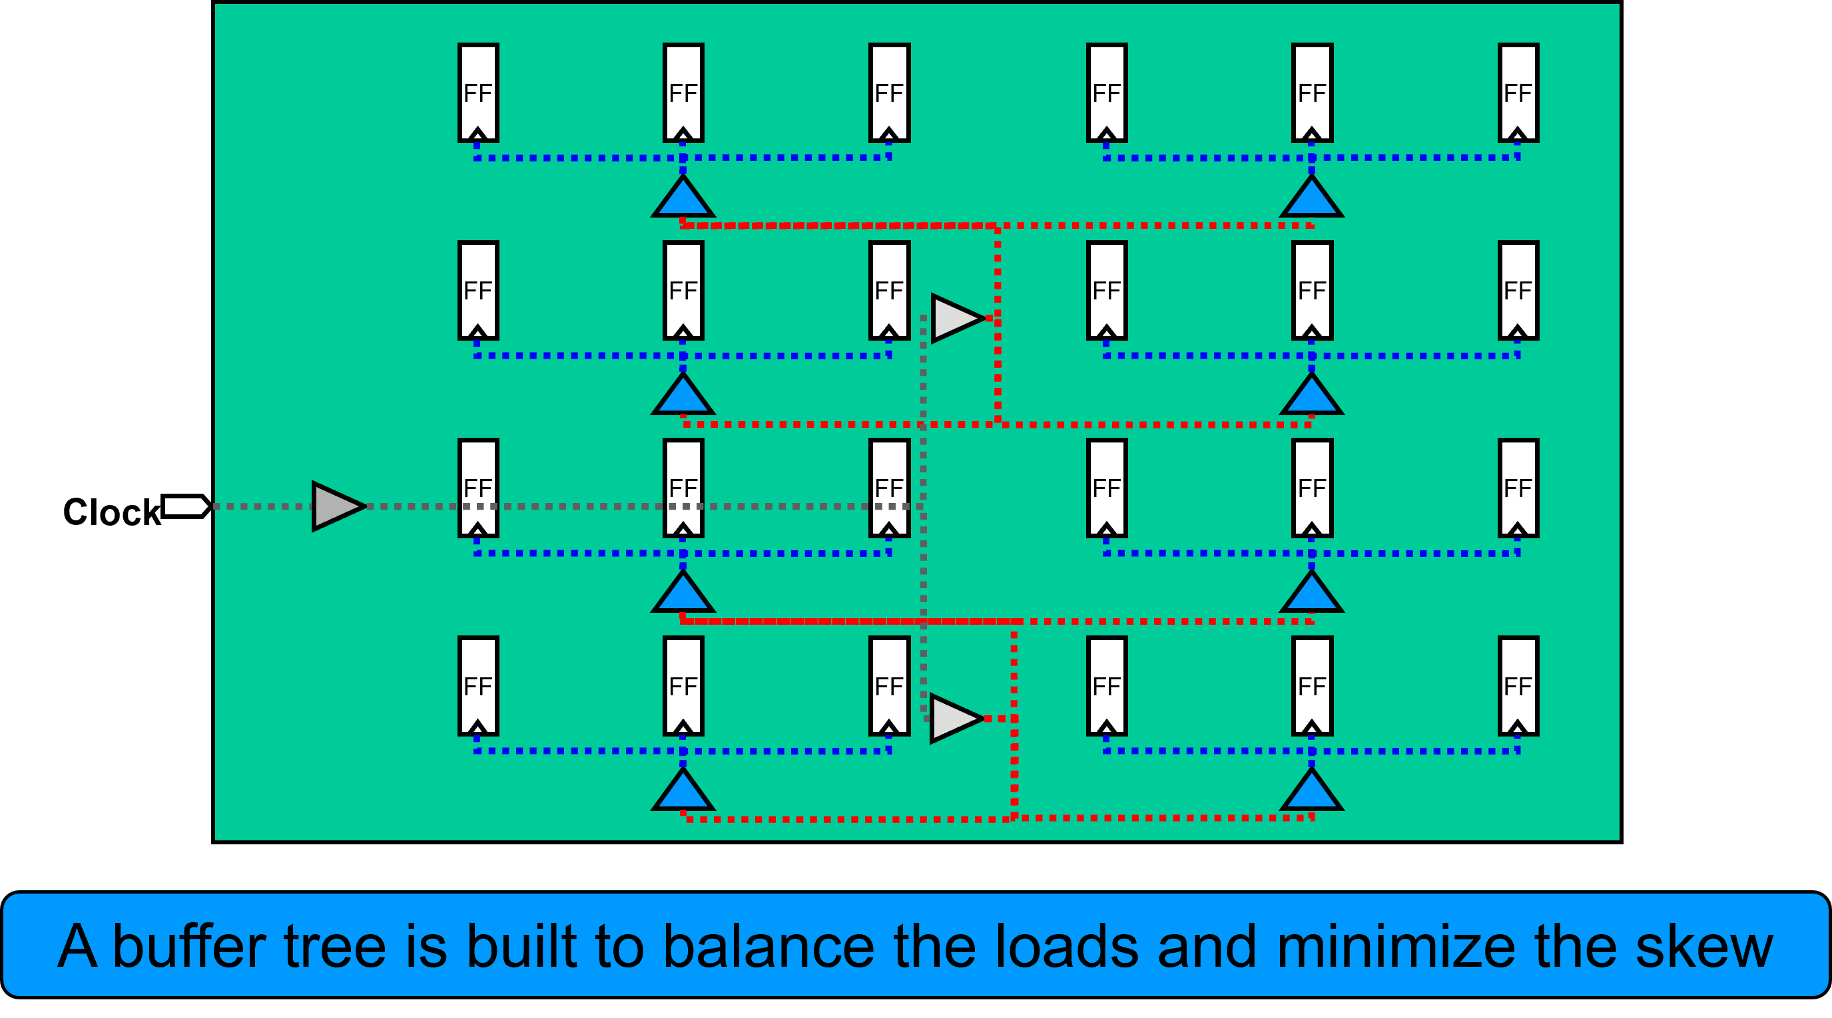
Intro CTS CTO CTS CTS Balance Skew
Clock Tree Synthesis (CTS) (1/2)
ASIC Physical Design

Slide 10
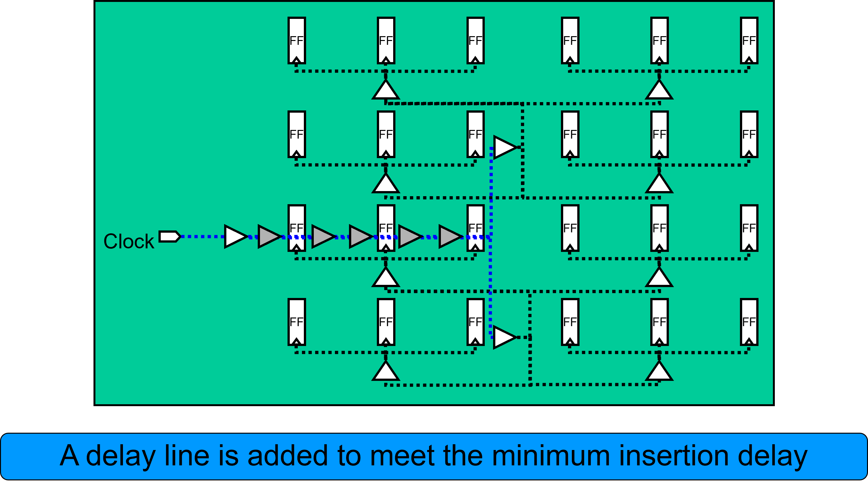
Intro CTS CTO CTS CTS Balance Skew
Clock Tree Synthesis (CTS) (2/2)
ASIC Physical Design

Slide 11
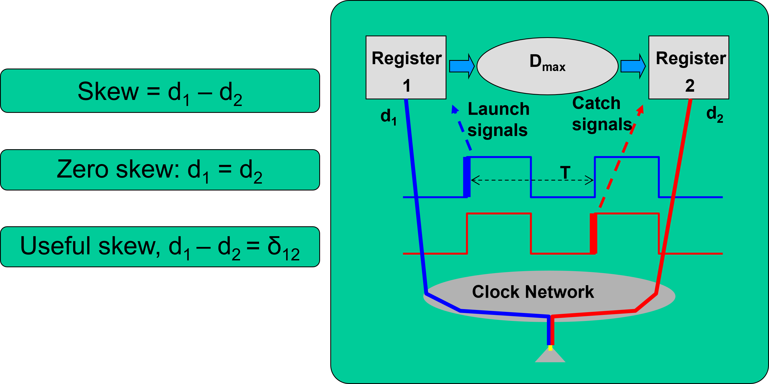
Clock Tree: General Concepts: Clock Distribution Network
Intro CTS CTO CTS CTS Balance Skew
ASIC Physical Design

Slide 12
Clock Tree: General Concepts: Clock Tree Goal and Metrics
Intro CTS CTO CTS CTS Balance Skew
Goal
Basic connectivity
Metrics
Skew Power Area
Slew rates
ASIC Physical Design

Slide 13
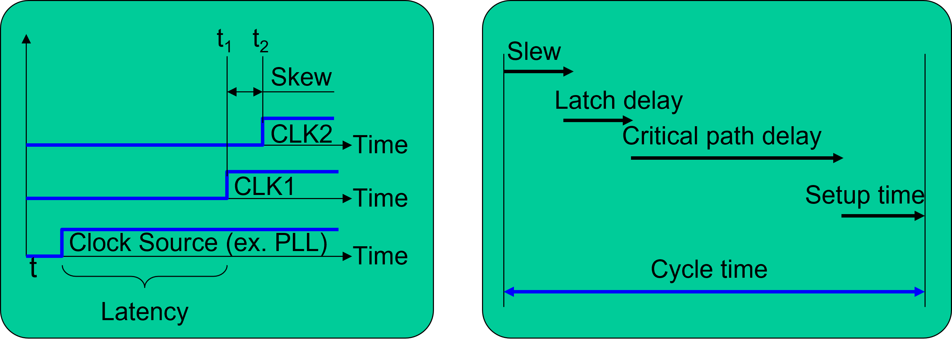
Clock Tree: General Concepts: Clock Skew: Definition, Causes and Effects
Intro CTS CTO CTS CTS Balance Skew
ASIC Physical Design

Slide 14
Intro CTS CTO
CTS CTS Balance Skew
Clock Skew Types
Global
Global skew is recommended - fastest may add unnecessary buffers
Local
Longer runtime
Possibly fewer buffers ” Only related FFs are balanced for skew ”
Useful
Used to fix small violations where local or global failed
ASIC Physical Design

Slide 15
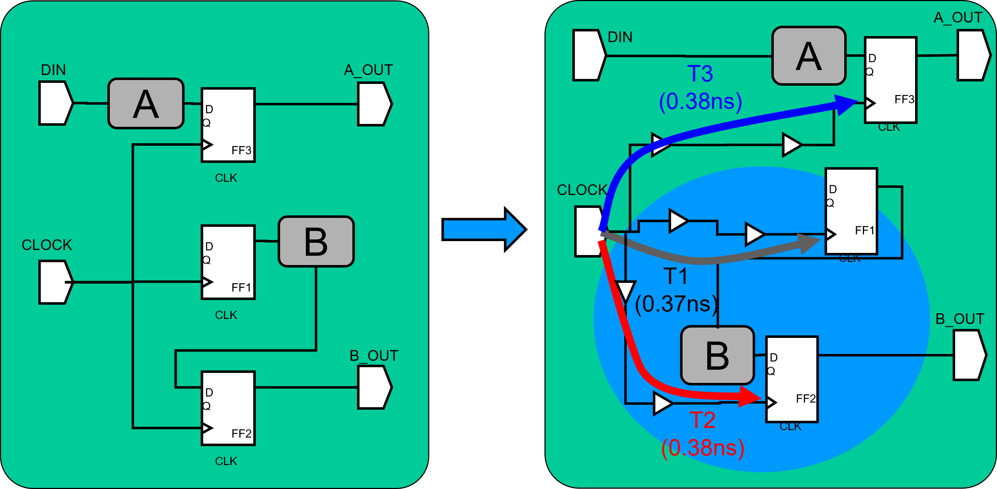
Intro CTS CTO
CTS CTS Balance Skew
Global Skew: Fastest Runtime
ASIC Physical Design

Slide 16
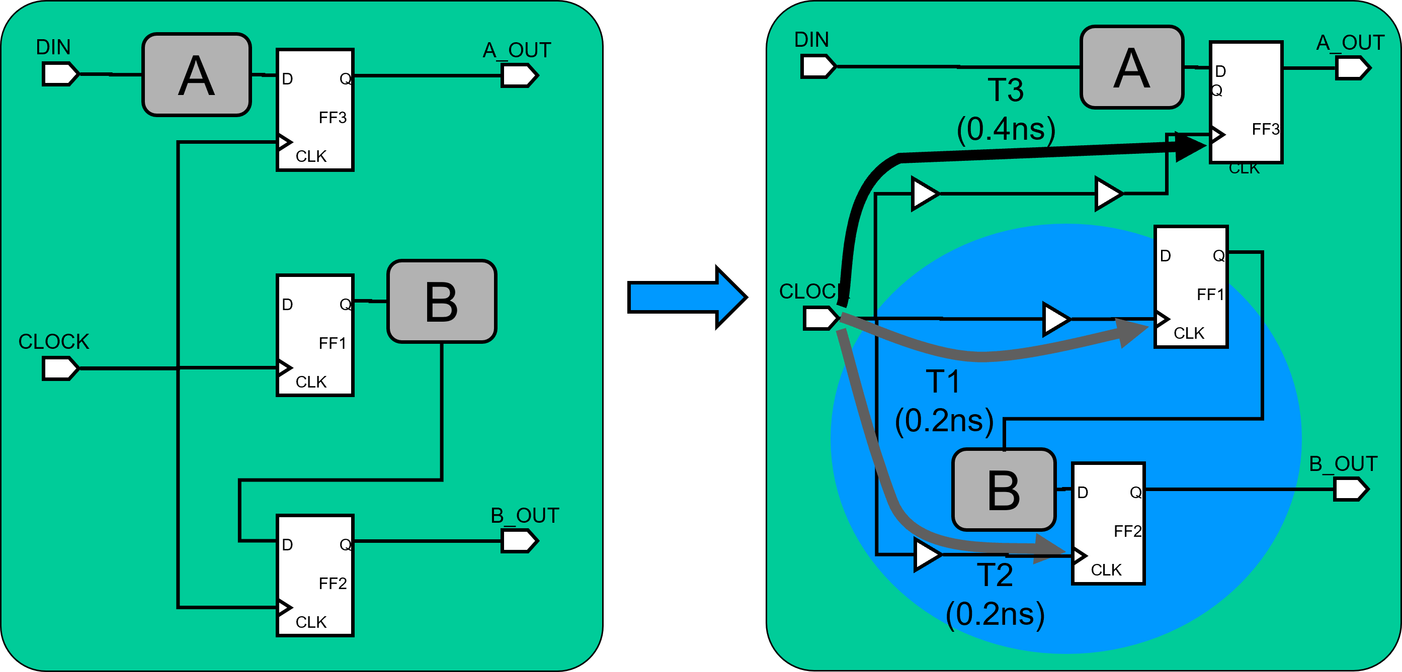
Intro CTS CTO CTS CTS Balance Skew
Local Skew: Targeted Synthesis, But Slower
ASIC Physical Design

Slide 17
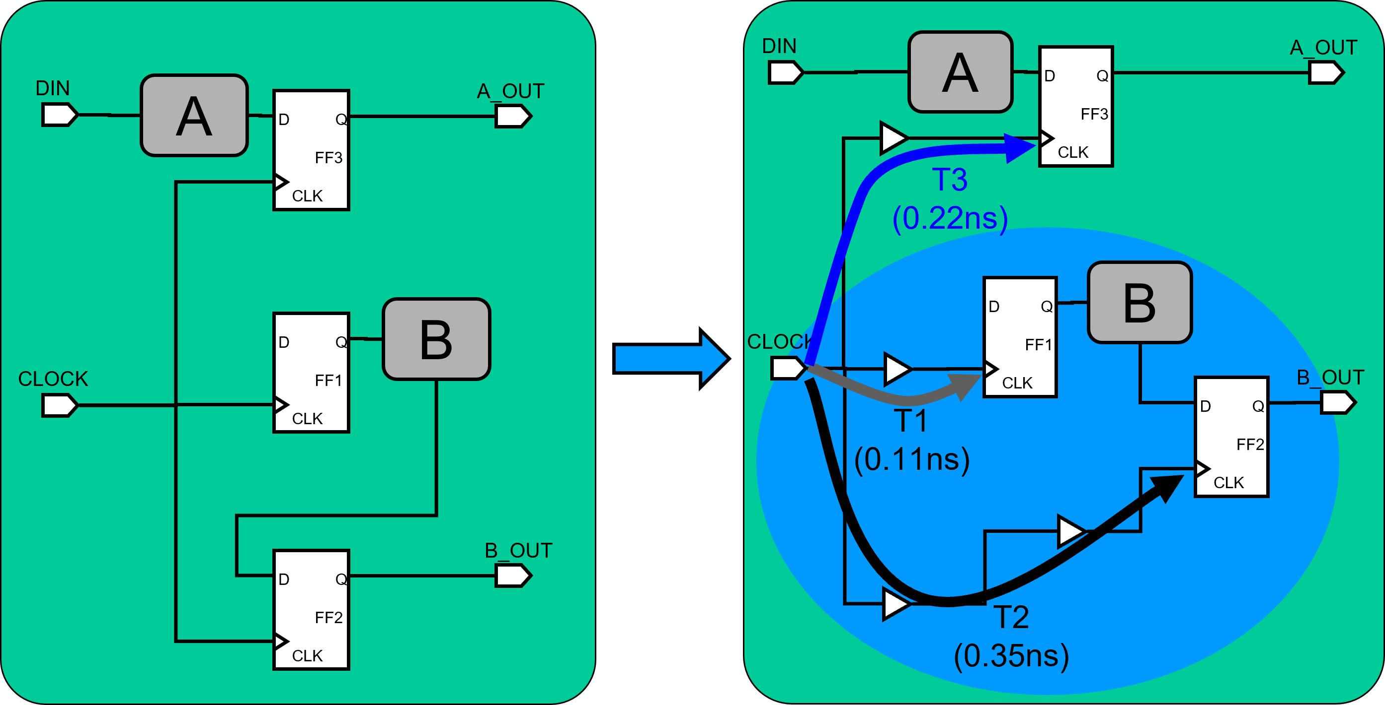
Intro CTS CTO
CTS CTS Balance Skew
Useful Skew
ASIC Physical Design

Slide 18
Intro CTS CTO
CTS Targets Cons Control NDR
Table of Contents
Introduction
Clock Tree Synthesis
Clock Tree Optimization
ASIC Physical Design

Slide 19
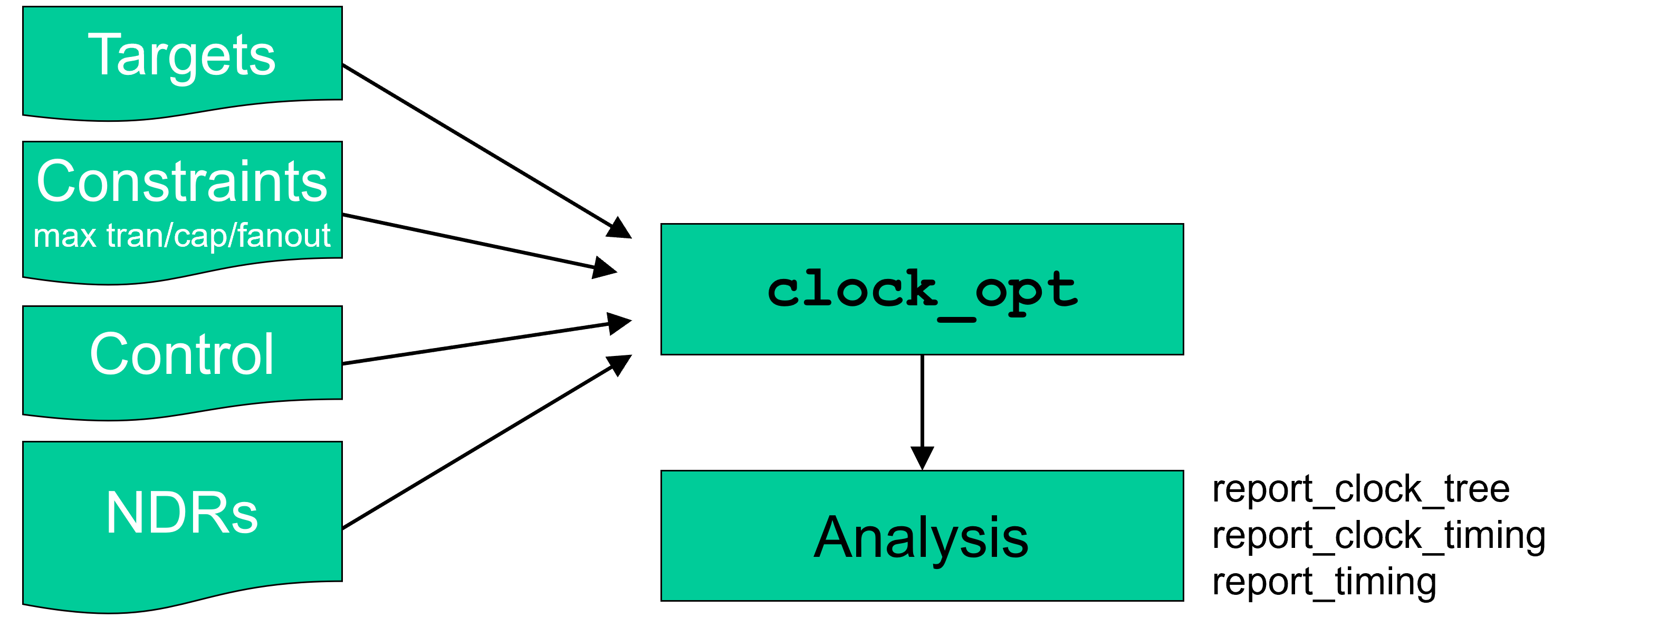
Intro CTS CTO
CTS Targets Cons Control NDR
Clock Tree Synthesis
ASIC Physical Design

Slide 20
Intro CTS CTO
CTS Targets Cons Control NDR
Clock Tree Synthesis
ASIC Physical Design

Slide 21
Understand Your Clock Tree Goals
Intro CTS CTO CTS Targets Cons Control NDR
Skew Goal
What are the skew requirements for your design?
Are there different skew targets for small and large clocks?
Insertion Delay Goal
What are the insertion delay specs for your block?
What is a reasonable target based on the size and floorplan of your block/chip?
Nondefault rules to prevent SI problems DRC Requirements
Are signal net DRCs different from clock net DRCs?
Find out the order of significance or importance of all the clocks in the design
ASIC Physical Design

Slide 22
Intro CTS CTO
CTS Targets Cons Control NDR
Default Clock Tree Targets
The default CTS target for skew and insertion delay is Ons
Uncertainty and insertion delay SDC constraints are ignored
It is recommended to relax the clock skew target as much as possible
Reduces overall buffer count, Power, and run time
Specify minimum clock latencies as needed
ASIC Physical Design

Slide 23
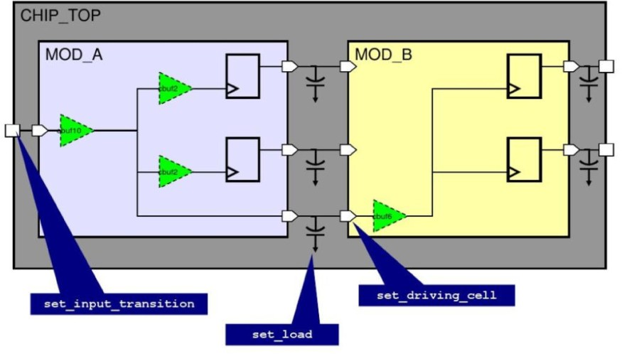
Constraints: Are all Clock Drivers and Loads Specified?
Intro CTS CTO CTS Targets Cons Control NDR
ASIC Physical Design

Slide 24
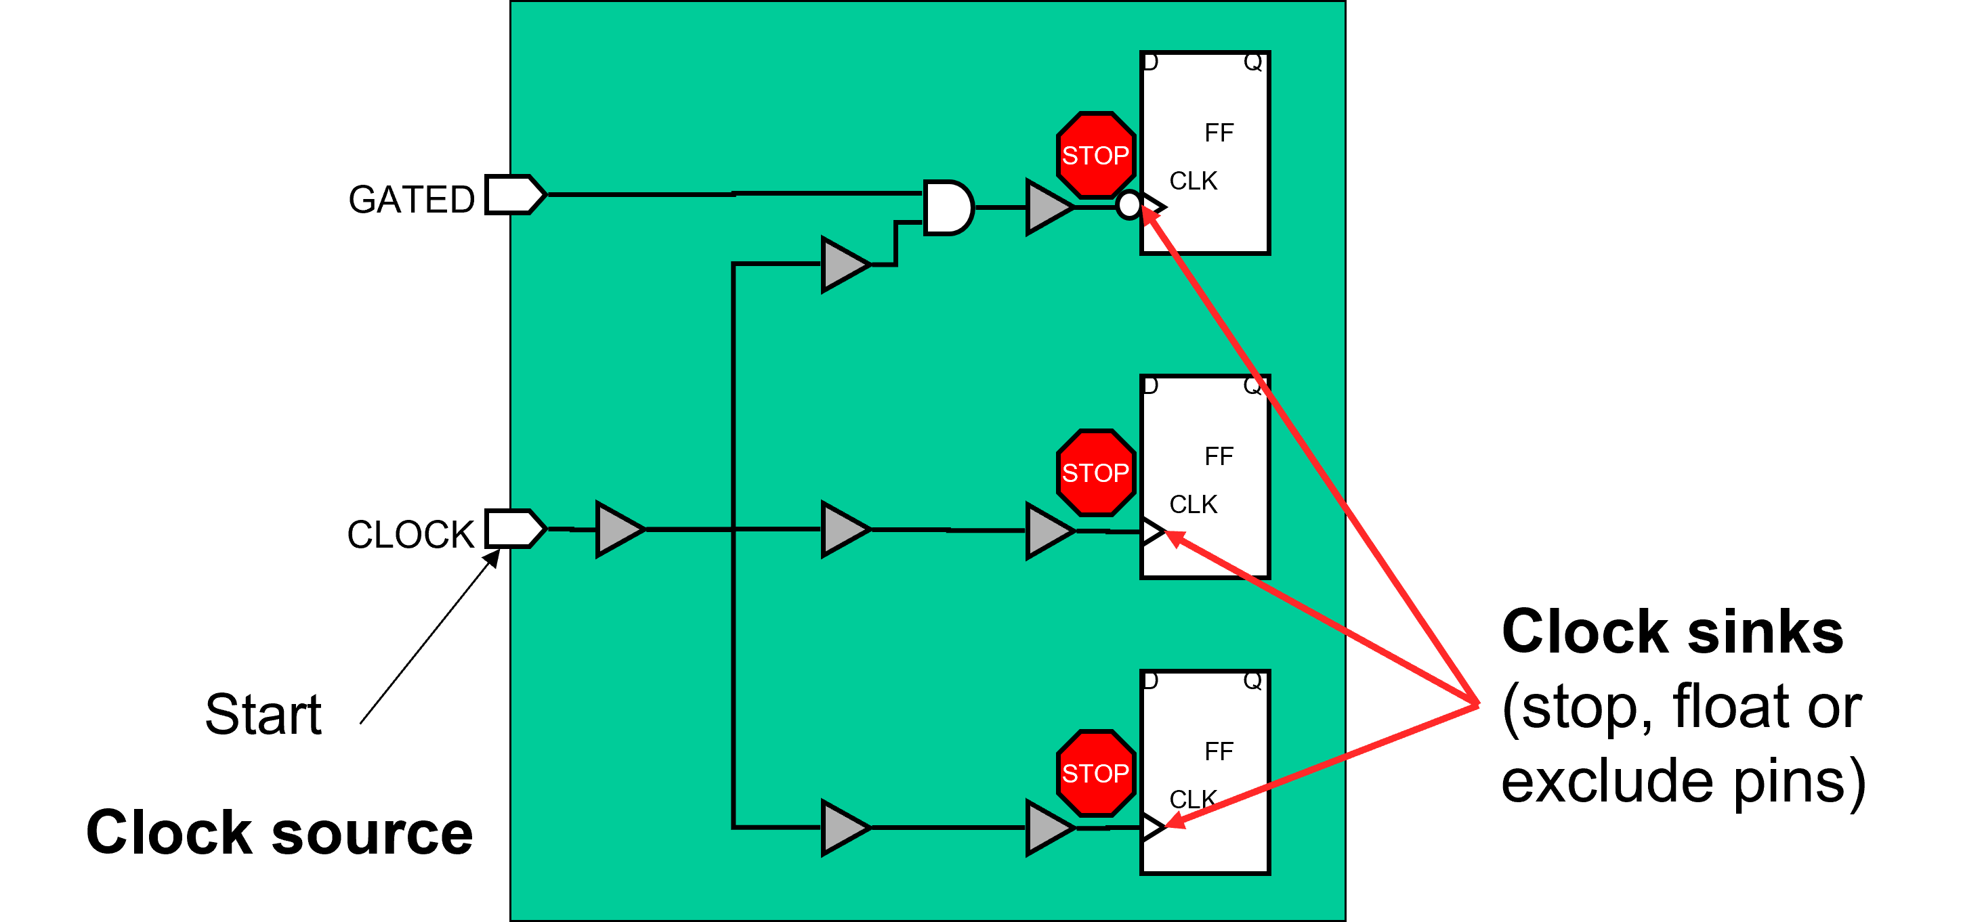
Intro CTS CTO CTS Targets Cons Control NDR
Where Does the Clock Tree Begin and End?
ASIC Physical Design

Slide 25
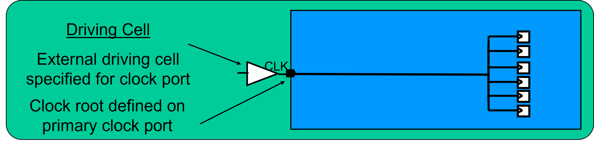
Define Clock Root Attributes (1/2)
Intro CTS CTO CTS Targets Cons Control NDR
When the clock root is a primary port of a block
Ensure that an appropriate driving cell is defined set driving cell
The synthesis constraints may include a weak driving cell for all inputs, including the clock port
Because the clock is ideal during synthesis it has no effect on
design QoR
But a weak driver on the clock port affects clock tree QoR during CTS
ASIC Physical Design

Slide 26
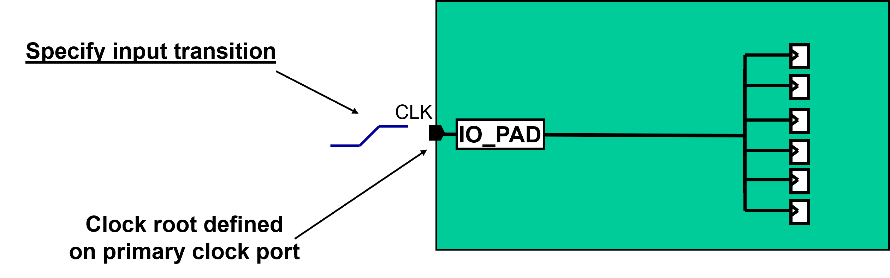
Define Clock Root Attributes (2/2)
Intro CTS CTO CTS Targets Cons Control NDR
When the clock root is a primary port, but at the CHIP-level through an IO-PAD
Ensure that an appropriate input transition is defined set input transition
ASIC Physical Design

Slide 27
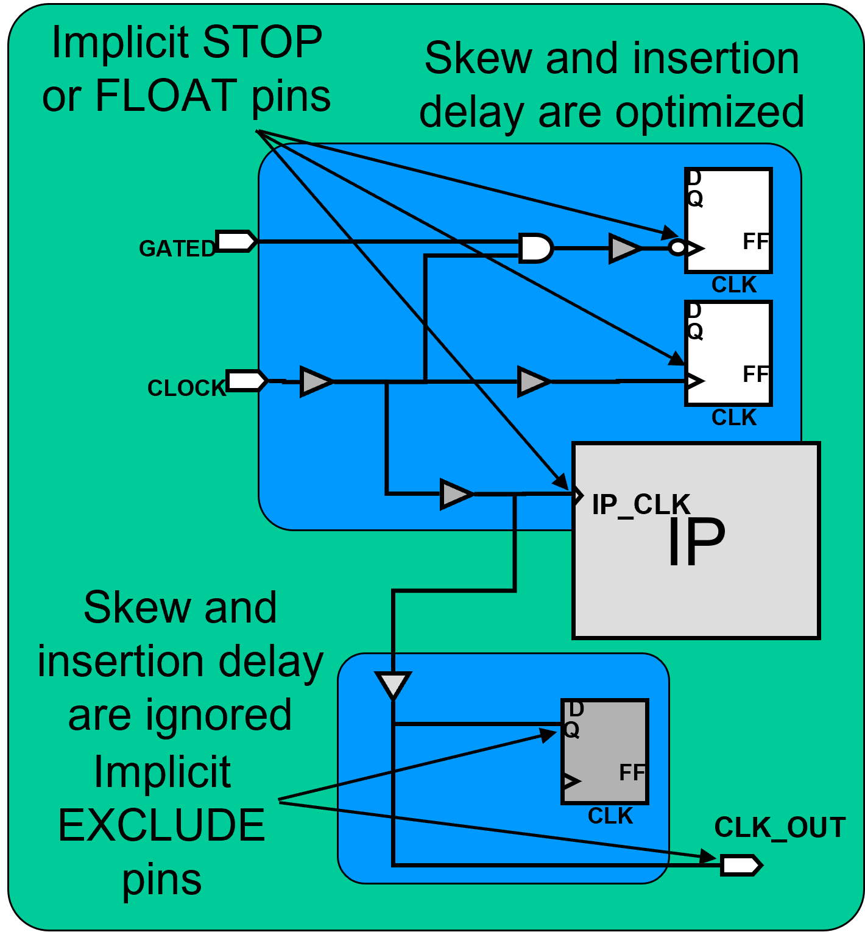
Intro CTS CTO
CTS Targets Cons Control NDR
Stop, Float and Exclude Pins
Stop Pins:
CTS optimizes for DRC and clock tree targets (skew, insertion delay)
Float Pins:
Like Stop pins, but with delays on clock pin
Exclude (Ignore) Pins:
CTS ignores skew and insertion delay targets
CTS will fix DRCs to meet library or SDC constraints
ASIC Physical Design

Slide 28
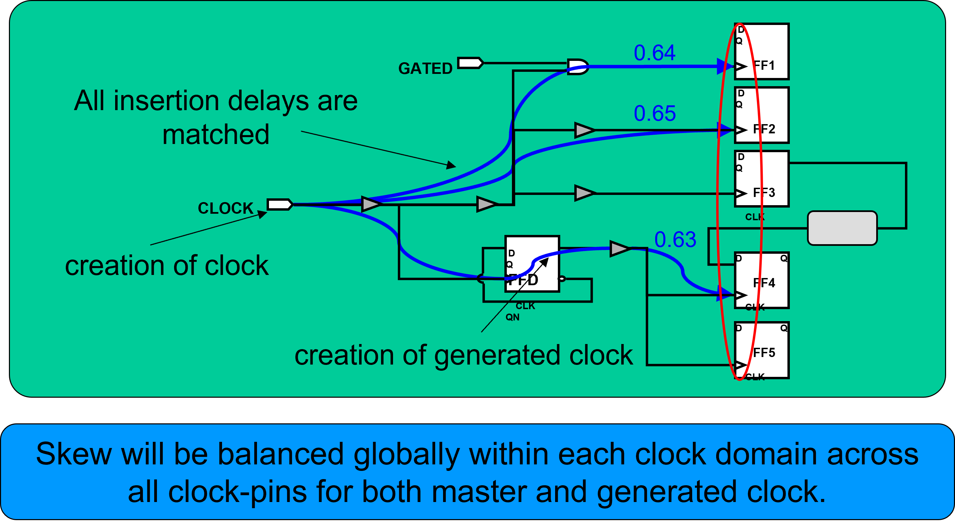
Intro CTS CTO
CTS Targets Cons Control NDR
Generated and Gated Clocks
ASIC Physical Design

Slide 29
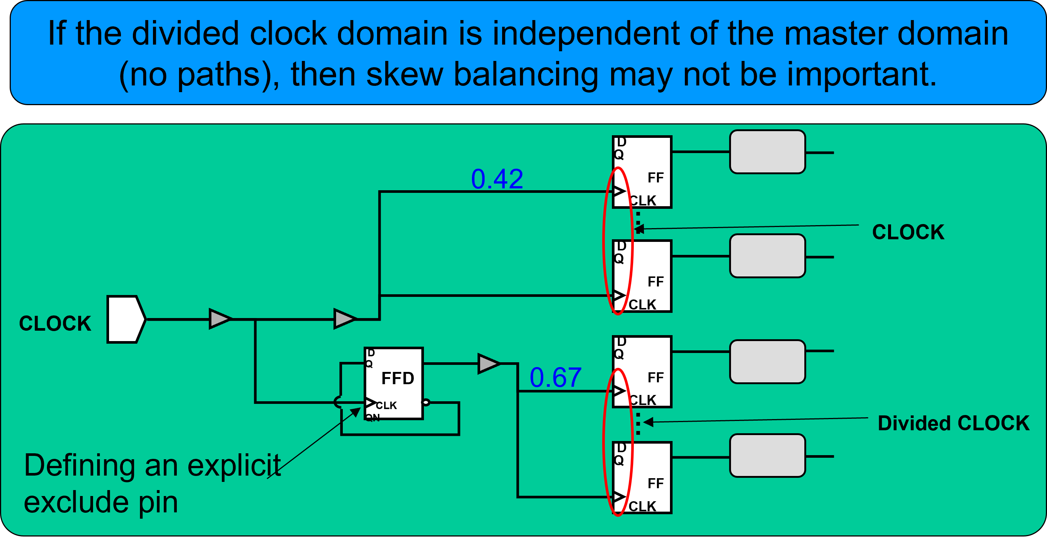
Intro CTS CTO CTS Targets Cons Control NDR
Skew Balancing not Required
ASIC Physical Design

Slide 30
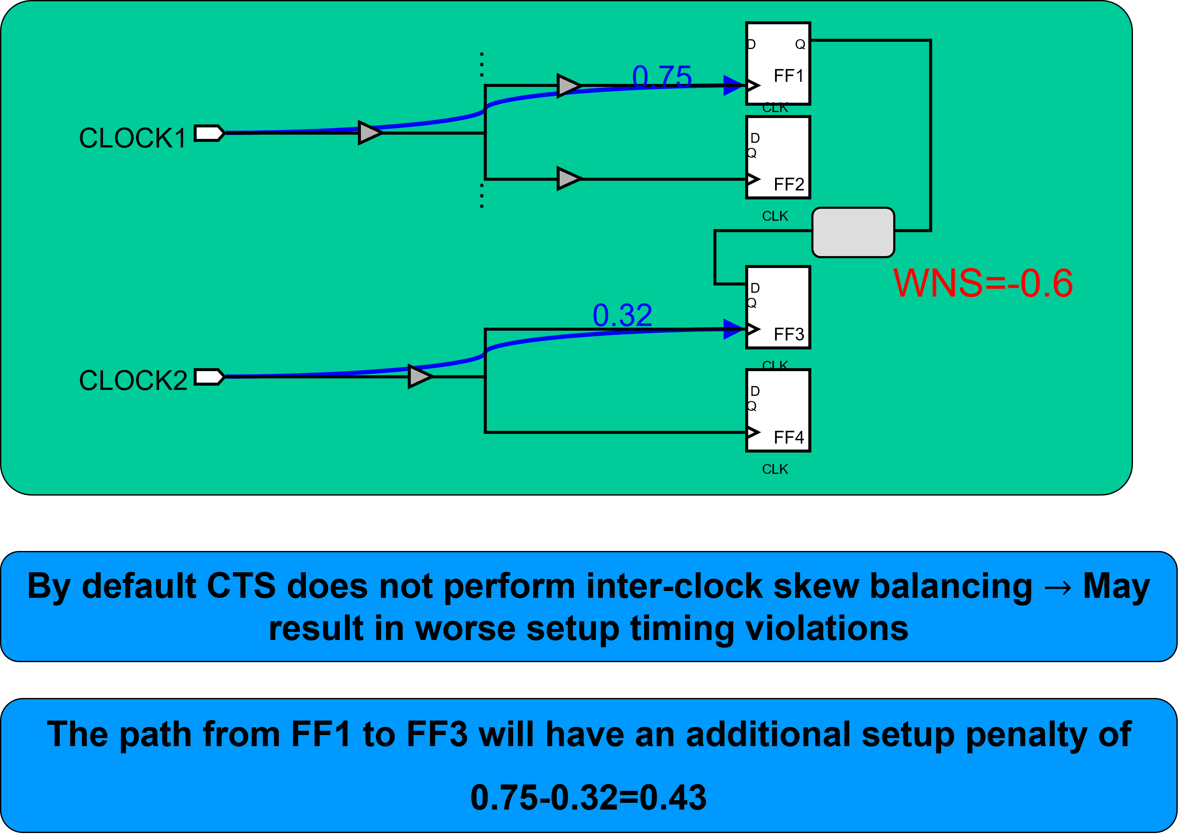
Intro CTS CTO CTS Targets Cons Control NDR
No Inter-Clock Skew Balancing by Default
ASIC Physical Design

Slide 31
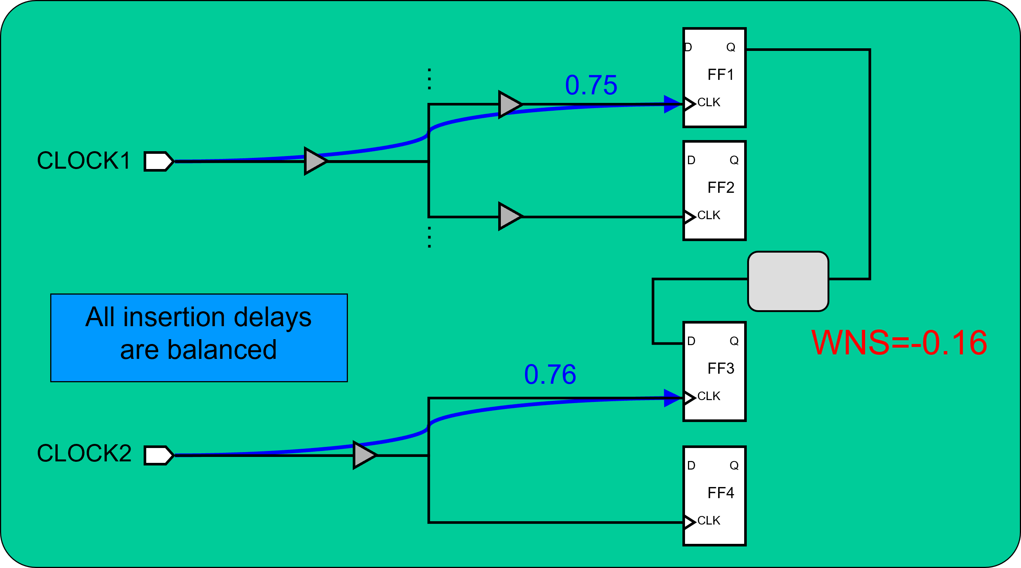
Intro CTS CTO
CTS Targets Cons Control NDR
Inter-Clock Delay Balancing
ASIC Physical Design

Slide 32
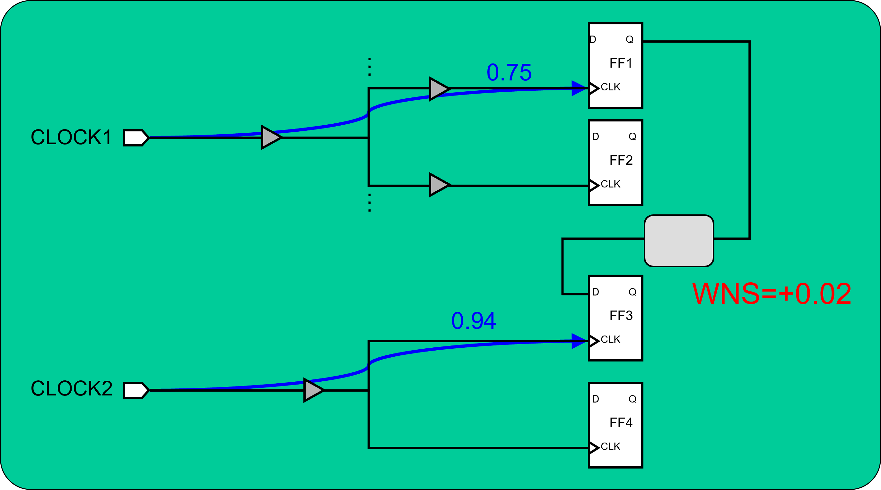
Intro CTS CTO CTS Targets Cons Control NDR
Inter-Clock Delay Balancing: With Offset
ASIC Physical Design

Slide 33
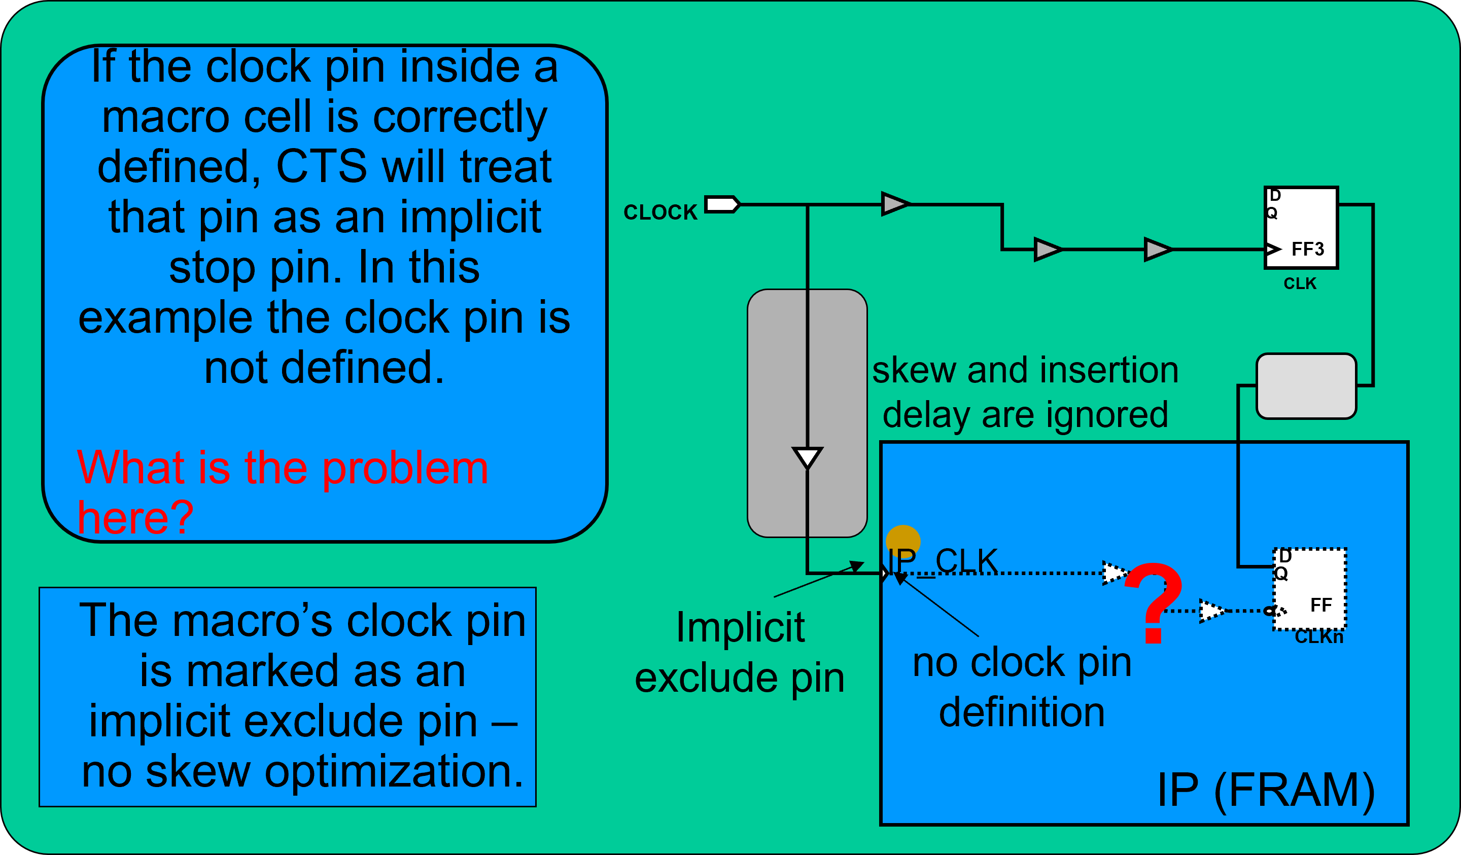
Intro CTS CTO CTS Targets Cons Control NDR
User-defined or Explicit Stop Pins
ASIC Physical Design

Slide 34
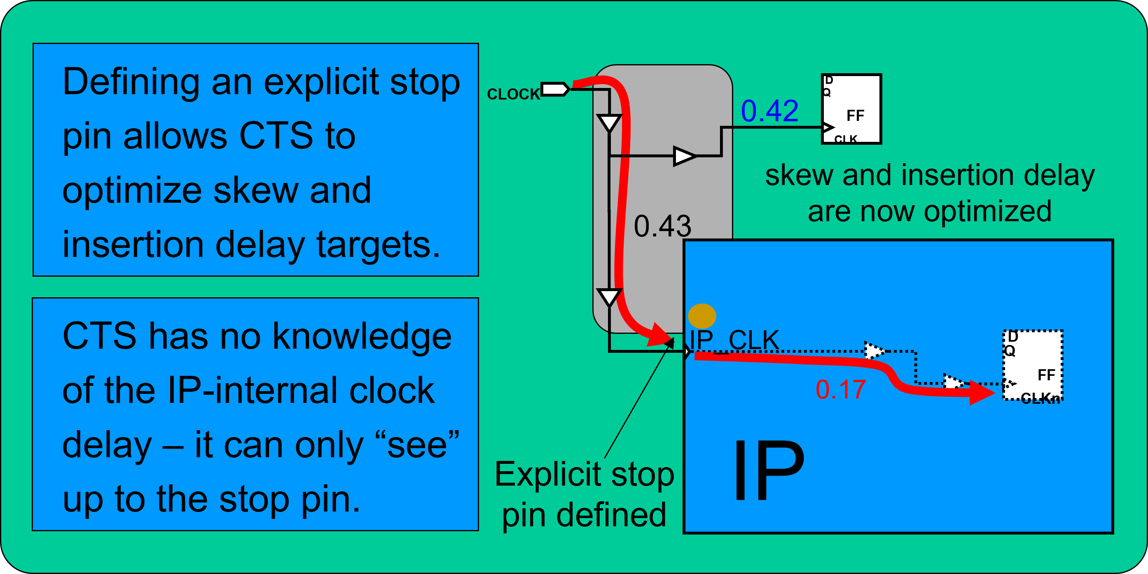
Intro CTS CTO CTS Targets Cons Control NDR
Defining an Explicit Stop Pin
ASIC Physical Design

Slide 35
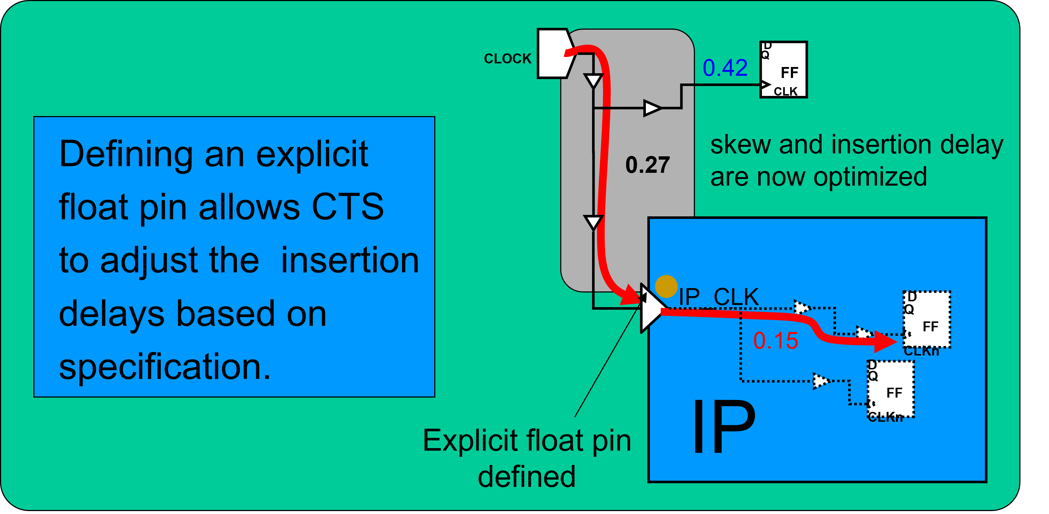
Intro CTS CTO CTS Targets Cons Control NDR
Defining an Explicit Float Pin
ASIC Physical Design

Slide 36
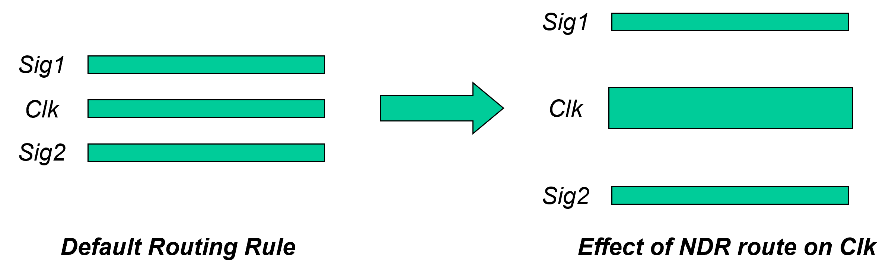
Intro CTS CTO
CTS Targets Cons Control NDR
Non-Default Clock Routing
PnR Tool can route the clocks using non-default routing rules,
e.g. double-spacing, double-width, shielding, and double via
Non-default rules are often used to “harden” the clock, e.g. to make the clock routes less sensitive to Cross Talk or EM effects, which improve yield
ASIC Physical Design

Slide 37
Intro CTS CTO
CTS Targets Cons Control NDR
NDR Recommendations
Always route clock on metal 3 and above Avoid NDR on Metal 1
may have trouble accessing metal 1 pins on buffers and gates
Consider using double spacing to reduce crosstalk Consider double width to reduce resistance
Consider double via to reduce resistance and improve yield
ASIC Physical Design

Slide 38
Put NDR on Pitch for Accurate RC Estimation
Intro CTS CTO CTS Targets Cons Control NDR
Metal traces are always routed “on pitch”
With clock NDR rules, pre-routing RC estimates of clock nets use NDR width and spacing numbers
If NDR [spacing + width] numbers are not integer multiples of pitch (i.e. off-pitch), timing estimates
pre-route may not correlate well with post-route timing
Make sure your NDR numbers are on pitch!
ASIC Physical Design

Slide 39
Intro CTS CTO
CTO Results
Table of Contents
Introduction
Clock Tree Synthesis
Clock Tree Optimization
ASIC Physical Design

Slide 40
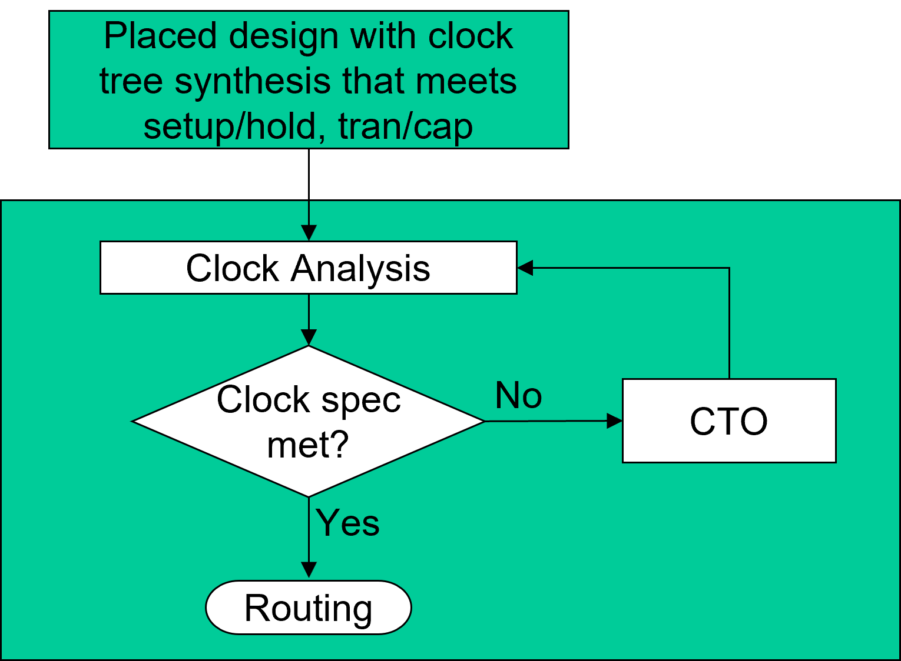
Intro CTS CTO
CTO Results
Clock Tree Optimization
Perform additional Clock Tree Optimization as necessary to further improve clock skew.
ASIC Physical Design

Slide 41
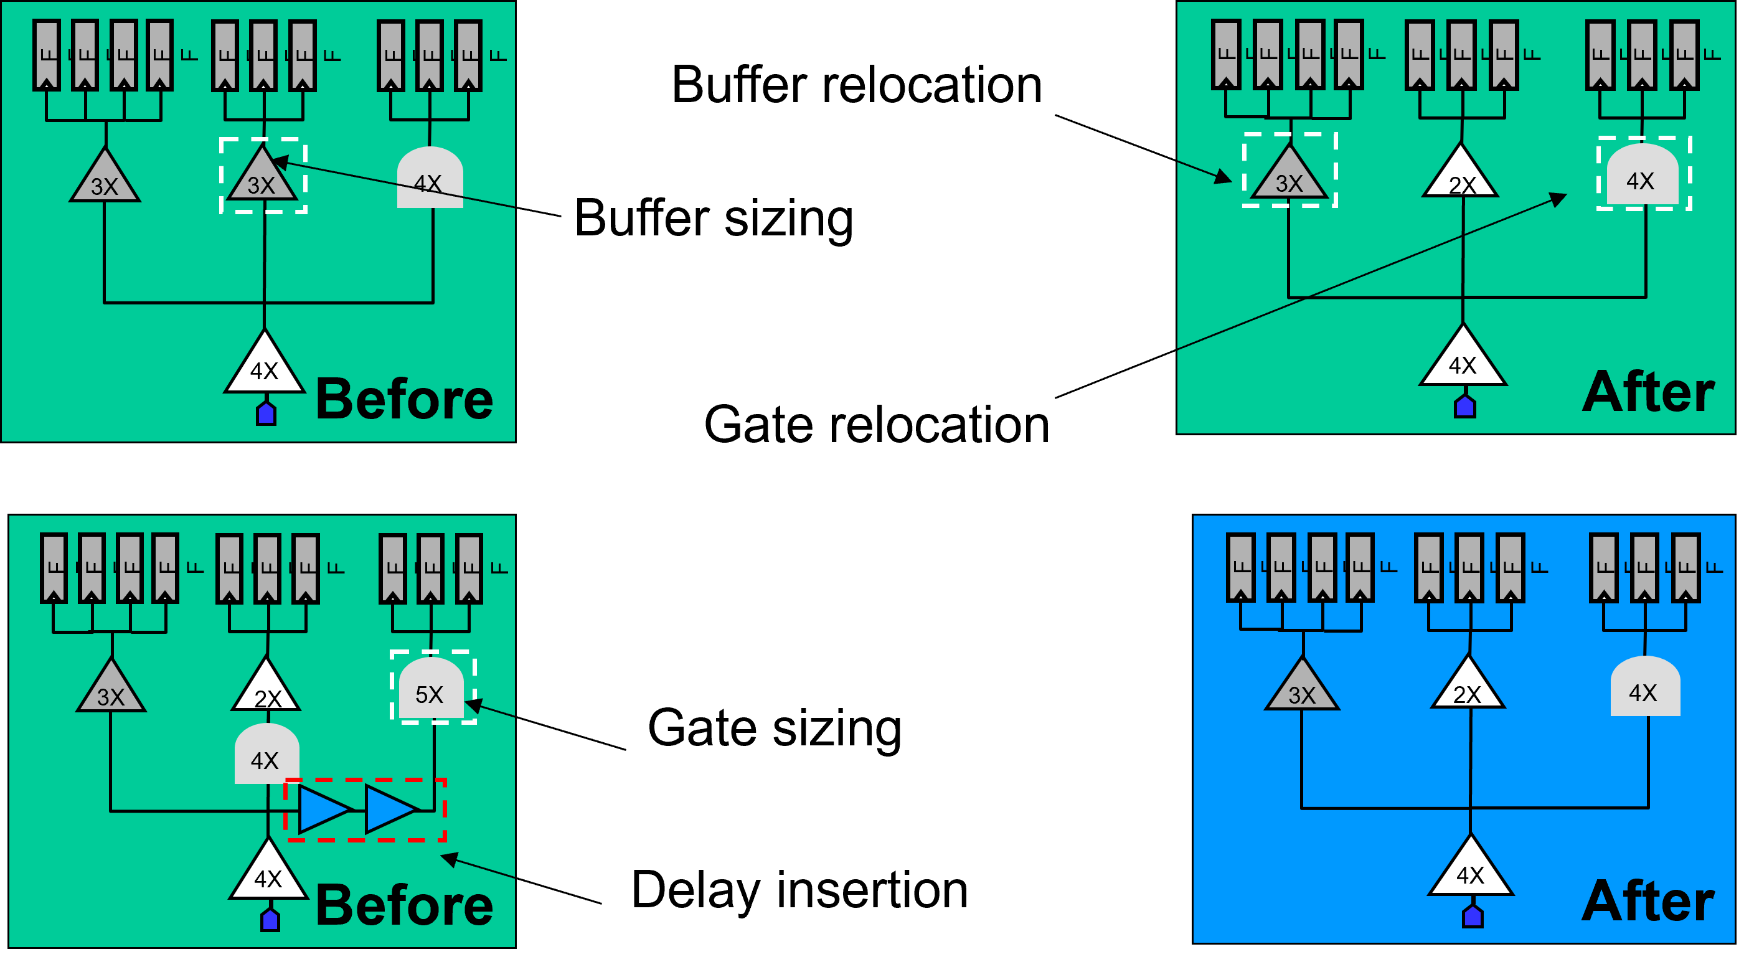
Intro CTS CTO CTO Results
Clock Tree Optimization Options
ASIC Physical Design

Slide 42
Intro CTS CTO
CTO Results
Analyzing CTS Results
Report clock tree Summary Settings
. . .
Reports max global skew, late/early insertion delay, number of levels in clock tree, number of clock tree references (buffers), clock DRC violations
Report clock timing
Reports actual, relevant skew, latency, interclock latency etc. for paths that are related
ASIC Physical Design

Slide 43
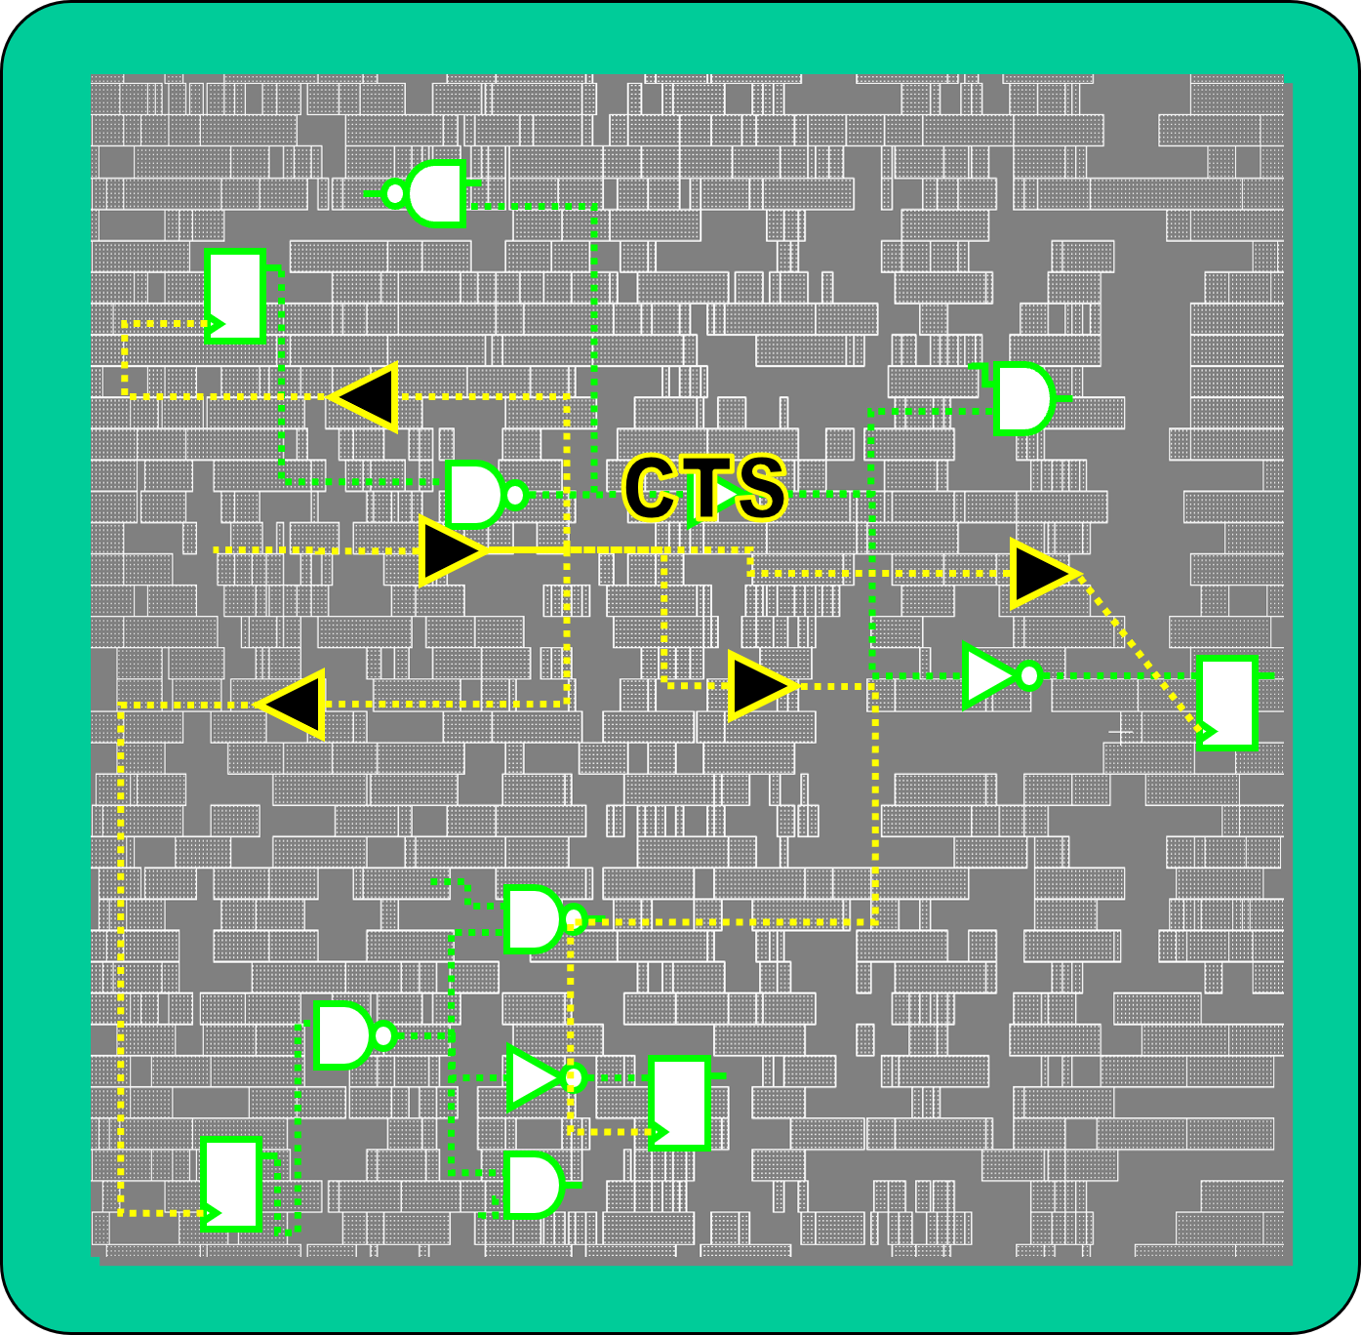
Effects of Clock Tree Synthesis
Intro CTS CTO CTO Results
Clock buffers added Congestion may increase
Non clock cells may have been moved to less ideal locations
Inserting clock tress can introduce new timing and max tran/cap violations, which will be checked in the next stages
ASIC Physical Design

Slide 44
Intro CTS CTO
CTO Results
....
_{z}r(_{沁}>)^{z}JI v一 ＿ ^{z}一)^{z}JI _{z}人＿l^{z}JI _{z}r(.~J_{z}2
' ₋z 已^{z}
. -， - ^{，仁} z z
.二.J ^{z}一
广沁l_{z}, \_{仁z}I _{z}r _{z} I v.._{z} r(广沁 _{z}勺I l..勺
ASIC Physical Design

